Slide 1

Lecture 4

Slide 2
Previous Lecture
Basics of a report
Expectation and purpose
Significance of a report
Report characteristics
Relevance, attributes and features of a report
Comparison of a report and essay

Slide 3

AUDIENCE
Technical Reader
Managerial Reader
General Reader

Slide 4

Technical Readers
Technical Readers have sufficient knowledge with respect to the subject matter which is why all they require is the latest information which they can use to interpret and draw a conclusion.

Slide 5

Managerial Readers
Managerial Readers have a hectic schedule which is why they are interested to get the gist of the content. In other words, they are interested in reading the executive summary of your report.

Slide 6

General Readers
General Readers (lay readers) do not have sufficient knowledge with respect to the subject matter. Thus, they require details for the comprehension of information provided within the report.

Slide 7
Technical Report Writing
A written account of events related to a scientific inquiry
An exercise to effectively communicate technical information
An interpretation of graphs, tables and figures using language
Organization of information to present findings

Slide 8
PURPOSE
INFORMATION
INSTRUCTION
DESCRIPTION
EXPLANATION
MECHNISM

Slide 9
EXAMPLES
Technical Report
Description
Instruction
Resume
Memorandum
Press Release
E-mail

Slide 10
Universal Characteristics of a Report
Report writing involves the use of active voice with the use of active verbs to make it more effective and appealing for the audience.
It is written in third person to remove the element of subjectivity from the content.
The use of personal pronouns is avoided to maintain objectivity.

Slide 11
Universal Characteristics of a Report
The conventional structure of a report has page margins of usually one inch on all sides.
MLA or APA citation style is used for citation of sources in order to avoid plagiarism.
Using another author’s words as it is or using Deep Seek/ChatGPT for the write-up is also considered plagiarism.
Credible authors and their content is cited to establish the authenticity of the content and discussion provided within a report

Slide 12

Structure of a Report: Overview
Title Page
Abstract
Table of Contents
Introduction
Design and Procedure
Results and Discussion
Conclusion
Work Cited/Bibliography

Slide 13
Title Page
A title page is also known as the cover page.
It provides the details of
Addresser (From)
Addressee (To)
Date of submission and
The title itself.

Slide 14
Abstract or Executive Summary
The cover page or the title page is followed by a short summary of the whole report.
This short summary is technically called the executive summary.
It is supposed to be qualitative, thus the adjective “executive”.
This executive summary should clearly define the purpose and the outcome of the whole study with pertinent results without using any abbreviation to confuse readers.

Slide 15
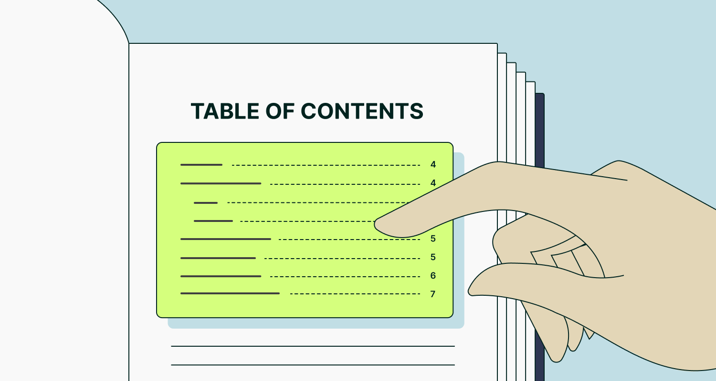
Table of Contents
The Table of Contents (ToC) is a page which provides the details of all the sections and subsections along with a reference of pages where those sections can be studied in a tabulated form.

Slide 16
Introduction
The introductory section of a report describes the problem for the readers, elaborates the objectives, explains the methodology used for the collection and analysis of data followed by highlighting the most interesting results to catch the attention of readers and to draw a conclusion.
The information is provided using the technique of conciseness.

Slide 17
Design and Procedure
This section involves the theoretical description of the research design used for the analysis of the report.
This section can also cover the previous testing of the particular design under consideration.
No specific measurements are needed at this point. This section to has to be kept brief and clear.

Slide 18

Results and Discussion
The results and their interpretation is provided in this section with the application of figures, tables and diagrams etc.

Slide 19
Conclusion
This section sums up all the results of the study in a quantitative manner, maintaining brevity.
Authors must strive to avoid the use of abbreviations as it will be read by readers who have earlier read only the executive summary without any idea of the body content.

Slide 20
Conclusion
The conclusion must highlight the studied problem, explain the basic objectives and the procedure to collect and analyze the data, and the most important results once again to get attention of the readers.
Objectives
Data
Result
Process

Slide 21
Work Cited/Bibliography
A detailed list of all the resources which have been studied to develop understanding of the subject matter must be included in the bibliography.
Works on which the report is based on may be cited and included in the work cited or references section.
The inclusion of this section at the end follows a certain format, as well.

Slide 22
Work Cited/Bibliography
There are different formats of citations to prepare the work cited page or bibliography. Some authors use end notes for this purpose.
Most of the researchers related to social sciences, arts and humanities use the MLA (Modern Language Associations) style whereas the studies based on natural sciences use the APA (American Psychological Associations) style.

Slide 23

Language of a Report
Clarity within a report can be maintained with the use of active verbs rather than the passive verbs.
Brevity can be ensured with the use of simple and declarative sentences.
Objectivity can be achieved by avoiding the use of first person singular and plural.

Slide 24
Deductive Report vs. Inductive Report
There are two modes of report based on the manner of reasoning and drawing conclusion for initiating an action.

Slide 25
Deductive vs. Inductive Reasoning
Deductive reasoning is a logical process that uses general ideas to form specific conclusions.
For example, If A = B and
B = C, then A must equal C.
Inductive reasoning is a method of thinking that uses observations to form general conclusions.
cause-and-effect reasoning’, involves using specific examples and observations to draw general conclusions.

Slide 26
Deductive Report
This is the mode of report where general information is used to draw a specific conclusion. The order of sections is as follows:
Introduction
Conclusion
Recommendations
Discussion

Slide 27
Deductive Report
This mode of report writing is suitable for audience who is running short of time and can only read ‘Conclusion and Recommendations’.
It is also used to deliver routine messages which present neutral information. For example, progress report of an employee.

Slide 28
Inductive Report
In this mode of report, the discussion precedes the conclusion. In other words, you generalize your conclusion based on a specific discussion at the outset of report. The sections are as follows:
Introduction
Discussion
Conclusion
Recommendations

Slide 29
Inductive Report
It requires the provision and use of factual information to draw a conclusion.
Such types of reports are used in case of informed readers who offer a strong and anticipated resistance with respect to the problem under investigation.

Slide 30
Deductive vs. Inductive Report
Introduction
Conclusion
Recommendations
Discussion
Introduction
Discussion
Conclusion
Recommendations

Slide 31
Summary
Structure of report
Key part of a report
Deductive reasoning
Indicative reasoning
Inductive vs deductive report

